Slide 1
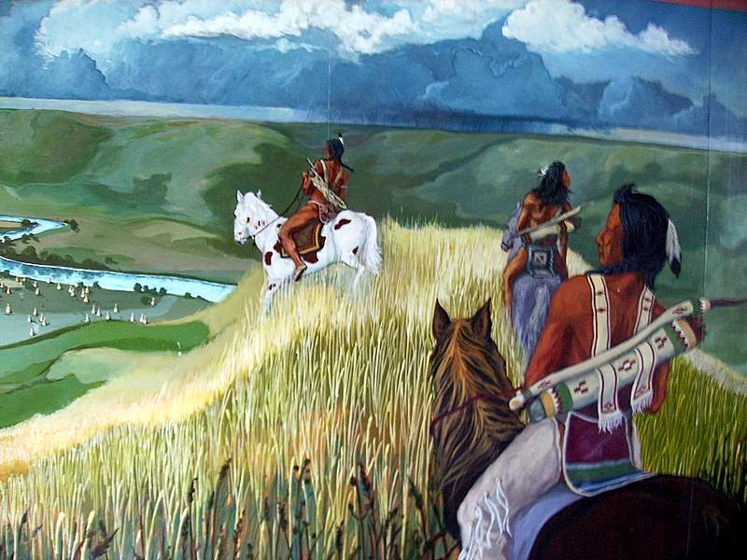
NATIVE AMERICAN TRADITIONS

Slide 2
I. Diversity and Unity
a. Religion center of Indian ethnic identity
b. Ordinary and extraordinary fused –Albanese’s categories don’t work here.
  Daily life customs and worship/spirituality flow into each other
c. 5 language groups; 550 different Indian societies and languages
d. thought each people had its own religion – not evangelistic
e. no conversions unless adopt

Slide 3
II. Common characteristics
strong sense of continuity with things held sacred, belonging to the world and in it.
b. Bound to the world in kinship ties
c. ties to sacred and pre-history
d. myth (sacred stories) give meaning to history – makes it understandable.

Slide 4
II. Common characteristics
e. outer world of nature sacred, personified,
f. inner world of visions sacred, dreams
g. names indicate something about a person and relationship with nature.
h. change names when significant event happens

Slide 5
II. Common characteristics
i.TRANSFORMATION= basic principle of nature, trickster figure part of transformation, breaking boundaries
j. ceremonies highlighted importance of transformation
  Clowns, creative disorder, transformation epitomized - acted out in ritual – pueblo kachina dancers impersonated gods, shamans break boundary between humans and gods in hunter societies

Slide 6
II. Common characteristics
k. Religious tasks: turning themselves to a harmony with nature. Harmony confers power, solemn recitation of origin myths, sacred forces touched in ritual.
  Ex: each ritual starts with orientation in space - 5, 6,7 directional points. 4 corners plus person or 4 corners plus up and down, 4 corners plus up and down and person.
Because sacred is all around them and they are part of the same stuff as nature, can be centered within sacred nature.

Slide 7
III. Oglala Sioux
A. General characteristics
a. 1 of 31 nations in Midwest 19th c North America
b. on prairies, Mississippi River to Rockies
c. Lakota (language)
d. Buffalo hunters.
e. C 1750 - horses; led to flowering of Sioux culture

Slide 8
III. Oglala Sioux
B. Origin Story
a. Emergence from earth
b. Trickster (inktomi) spider, promises vs reality, six families of people agree to follow him up to surface, are cold and hungry. Old Man and Old Woman teach them to plant corn, hunt, make clothes, survive. First people in world.
1. Shows trust and high regard for elders
2. History of Oglalas not world in general
3. A people of the earth.

Slide 9
III. Oglala Sioux
LIKE ALL MYTHS/SACRED STORIES, THIS ONE IS TRUE.

Slide 10
III. Oglala Sioux
B. Origin Story
Also origins of rituals = sacred pipe, sweat lodge, etc. each located Oglala in world of meaning by a centering process w/ regard to space.
VISION QUEST: ritual tailored to individual character but put individual in powerful cosmos-community. Began and ended in community.
e. SUN DANCE : only rite occurring at specific time of the year, after buffalo harvest, early summer, hunting version of a harvest festival/ first fruits.

Slide 11
III. Oglala Sioux
f. MAKING OF RELATIVES:
commit 2 people in bond closer than friends, blood relatives. Dying for each other if necessary.
g. PUBERTY RITE FOR GIRLS
at 1st menstruation , secured a relationship for her with White Buffalo Calf Woman, (divine being).
h. SACRED BALL GAME:
ball symbolizes wisdom. Thrown to 4 directions, struggle to catch it symbolizes struggle over ignorance.

Slide 12
III. Oglala Sioux
TERMS:
a. WAKAN:
the dimension of reality that causes transformation. Holiness itself.
b. WAKANTANKA wakan in its greatest aspect, God idea, 16 different god beings who collectively were WAKANTANKA.

Slide 13
III. Oglala Sioux
IDEAS:
a. sacredness is a quality suffusing all things, gods are ambiguously personified so both are and are not separate from nature.
b. Buffalo is most wakanish being – use all parts of it. In that process it is transformed into the Sioux and their culture .

Slide 14
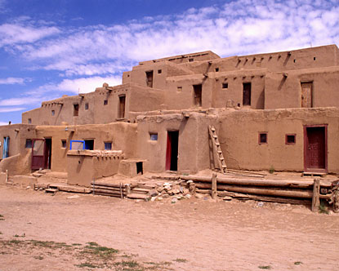
IV. HOPI
a. Pueblo Indians
[Spanish term for people who lived in stone, mud, or brick multi-story apartment-like dwellings around a central square. Community could hold hundreds or thousands of people. Distinctive to the southwest area of the U.S.]
b. Arizona, New Mexico desert, isolation from conquerors

Slide 15
Hopi
pueblo-de-taos.jpg
b. Arizona, New Mexico desert, isolation from conquerors
c. Settled over 2000 years ago, hunter gatherers, basketers.
d. 900 - 1300 c.e culture reached its peak, cliff dwellers, easily defended
e. Oraibi - ceremonial design for village dates back to around 1150 - 1300.Village design was a pattern of terraced apartments grouped around a central plaza where outdoor ceremonies would take place.

Slide 16
Hopi
f. agricultural traditions - corn, beans, squash. Women in charge of social leadership and clans. Matrilineal. Men do farm work and kachina rites.
g. Language = Shoshonean, related to Mezo-American culture & language group called Uto-Azteca.
h. Beliefs show hunter-gather past and farming. Awe of dead, healers. Emergence from earth, but slightly different story than Sioux. Learned to farm when came up from earth, taught by women, liturgical year tied to seasons, ideas about transformation more tied to changing seasons. Water is primary,
Each clan has a distinct religious responsibility for the whole community. rites to produce rain.

Slide 17
Hopi
i. Kachinas:
Are spiritual beings, intermediaries between people and the higher more distant divinities.
Are also men who wear masks depicting those beings when conducting special dances in the Kiva (pit house for this purpose).
Are also dolls given to children to teach them about the Kachina spirits. Recite emergence myth / story during Kachina rites. Also begin by locating selves in relation to 4 directions.
year divided into two halves - time of kachina rituals and not.

Slide 18
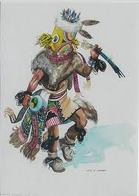
Hopi

Slide 19
V. CHANGES IN NATIVE AMERICAN RELIGIONS
4 GENERAL WAYS:
1. keep practices [this often requires a deliberate decision to avoid or reject influences from broader American culture]
2. Add elements of Christianity to traditional practices
3. Complete conversion to some form of Christianity and abandoning all traditional practices
4. Participation in a new Native American religious movement like the Ghost Dance

Slide 20
V. Changes in Native American Religions
WHY:
1. Colonial era: in areas of Spanish Roman Catholic missions (California and former Mexico areas of the southwest U.S.) .
Missions defended by conquering armies who took Indian land. Indians liked holidays such as All Souls Day or some saints days because it fit with their cosmology. Had no place for Jesus or heaven or hell ideas. Used Christmas as a prayer time and saints days for festivities. After the Mexican revolution in 1821 the Spanish were gone and the missions nearly abandoned, so Roman Catholic influence waned. More likely that elements of Christianity would be blended with Native American traditions or abandoned.

Slide 21
V. Changes in Native American Religions
2. Early 19th century Protestant Christian groups sent missionaries to Cherokees living in southeast U.S. 1801 Moravians, 1805 Presbyterians, Baptists, Methodists, Congregationalists. 1829 translated the gospel of Matthew into Cherokee and wrote a Cherokee hymnal.
Yet in 1838 the U.S. pushed the Cherokee out of the south to west of the Mississippi River – forced them to walk it. The Trail of Tears. The Cherokee resisted adopting Christian practices – had own marriage customs, thought sermons were boring, saw baptism similar to a Cherokee rite of their own.

Slide 22
V. Changes in Native American Religions
3. During the 19th century the U.S. expanded westward into Sioux territory. Increasingly so after the Civil War. William F. Cody (Buffalo Bill) , a scout for the U.S. Army, later became famous for killing buffalo. The U.S. saw it as a means of destroying Indian culture (the Sioux were not the only people dependent upon buffalo).
Today’s Oglala survive as a distinct people because of their religion. Buffalo are relatively rare and they have no economic link to buffalo any longer.

Slide 23
V. Changes in Native American Religions
4. From the late 19th century through the first half of the twentieth century, schools run by the U.S. Bureau of Indian Affairs (a federal gov. agency) on Indian reservations punished students for speaking the traditional native American languages they heard at home and insisted students speak English.
Also punished students for celebrating traditional holidays, taught the holidays of the U.S. calendar to replace them. Also instructed students in Christianity. Effort to wipe out traditional cultures and spread general U.S. culture to reservations. Made it more difficult for Native Americans to resist U.S. power.

Slide 24
V. Changes in Native American Religions
5. New religions emerged to find religious means to overcome power of U.S. and repair Native American societies weakened by loss of economic and political independence.
EXAMPLES:
1. Old Way of Handsome Lake: Gaiwiio.
Seneca Indian Revival (Iroquois Indians (association of 5 nations) in area of northeast U.S., dealt with white aggression earlier than Native Americans on the midwest and western plains areas. Effort to restore traditional ideas and morality – oath to reject alcohol , restore family traditions. Repair Seneca society

Slide 25
V. Changes in Native American Religions
2. Ghost Dance:
Plains area, late 19th century. Response to Indians thinking old religions failed as whites pushed them off their land.
Jack Wilson, (Wovoka), Paiute Indian from Nevada, claimed to have died twice and seen God. Message:
a. The earth will be destroyed by a flood
b. if Indians do the ancient round dance (ghost or spirit dance) water will wash under them while washing away the whites. Indians will survive, the earth will spring to life with abundance in new creation. Nevada Indians will be reunited with their ancestors

Slide 26
V. Changes in Native American Religions
c. Ghost Dance spread rapidly across U.S. Oglala Sioux learned the Ghost Dance, wore ghost shirts and believed the shirts would protect them from bullets – died in Wounded Knee massacre in 1890.

Slide 27
V. Changes in Native American Religions
6. Pan Indian movement: began in the second half of the 19thc century but had a stronger revival in late 20th century, especially after publication of 2 books : Black Elk Speaks (1932 ) and Bury My Heart at Wounded Knee (1970)
Black Elk Speaks: written by John G. Neuhardt, a U.S. poet and writer who tells the story and describes the spirituality of Black Elk, an Oglala Sioux medicine man. Translated from Lakota by Black Elk’s son, who was present during the interviews between Neuhardt and Black Elk. Reprinted in U.S. in 1961 and 4 later editions were widely read as part of a deepening appreciation for Native American spirituality. In 2008, SUNY Press published another edition.

Slide 28
V. Changes in Native American Religions
Bury My Heart at Wounded Knee, by Dan Brown, is a history of Native Americans in the western U.S. in the late 19th century. It has been translated into 17 languages and has never gone out of print.

Slide 29
VI. Summary
Summary:
Commonalities of Native American Religions:
1. Sense of continuity with sacred world
2. Kinship beliefs emphasized kinship with nature
3. No break between creation and history of the people
material world (natural) holy in itself
inner world holy in itself
boundaries between sacred and non-sacred realms not firm
4. Transformation occurs via the holy
5. Living in harmony with nature is the great religious task

Slide 30
VI. Summary
American Indian religions multiplied with coming of Christianity via blending and the creation of new religious movements.

